Slide 1


Lecture 2-6 BPEL and Other Development Frameworks Reading: Text Section 8.4
CSE446 / CSE598 Software Integration and Engineering
Unit 2 Software Development by Composition and Integration
Dr. Yinong Chen

Slide 2
Lecture Outline
BPEL Development Frameworks
Oracle SOA Suite: BPEL Process Manager and JDeveloper Designer
http://www.oracle.com/technetwork/middleware/fusion-middleware/overview/index.html https://www.oracle.com/technologies/developer-tools/jdeveloper/jdeveloper.html http://www.oracle.com/technetwork/articles/soa/index-095969.html
BPMN and BPMN Development Frameworks
http://www.oracle.com/technetwork/middleware/soasuite/documentation/oracle-bpm-modeling-guide-ps4fp-487996.pdf
Microsoft BizTalk
http://www.microsoft.com/BizTalk

Slide 3
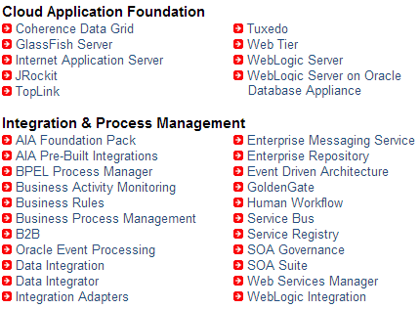
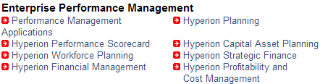
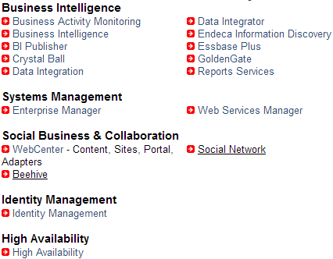
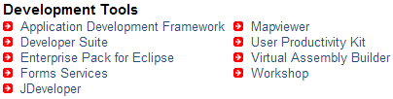
Oracle Fusion Middleware Family http://www.oracle.com/technetwork/middleware/fusion-middleware/overview/index.html

Slide 4
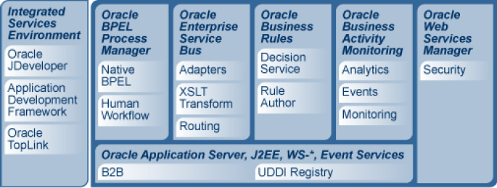
Oracle SOA Suite Architecture
https://www.oracle.com/middleware/technologies/soasuite.html

Slide 5
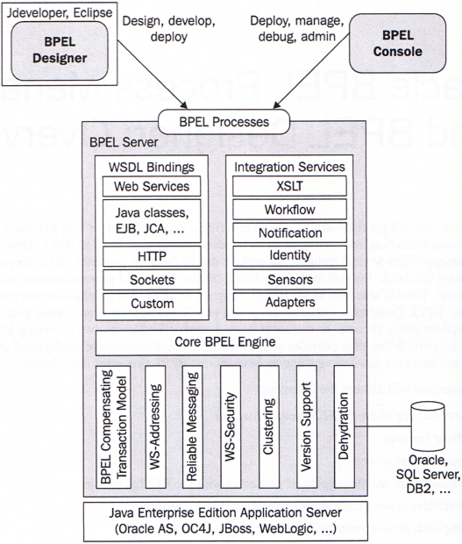
Oracle SOA Suite
1
2
Four Major Components:
BPEL Designer (Visual)
JDeveloper
Eclipse
BPEL Console
BPEL Process Manager
QoA management
BPEL Server for Hosting and Execution
Database
Oracle
SQL
DB2
3
IoT
4

Slide 6
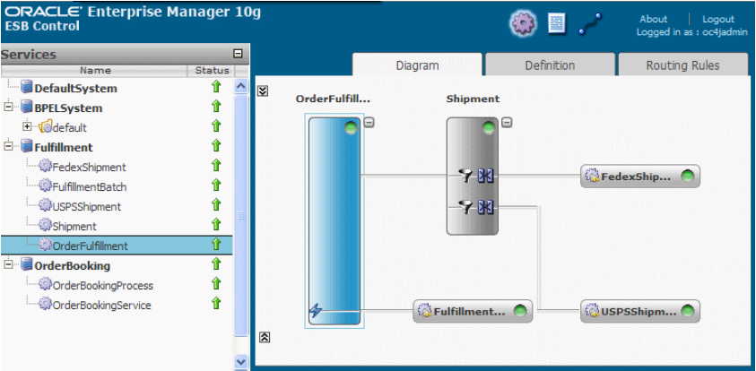
Architecture Design for e-Business Applications

Slide 7
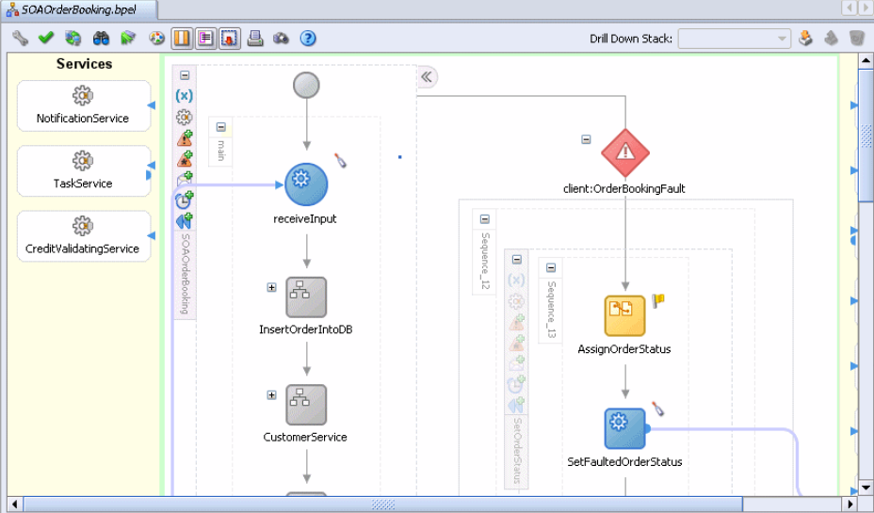
JDeveloper as BPEL Designer for Workflow Development

Slide 8
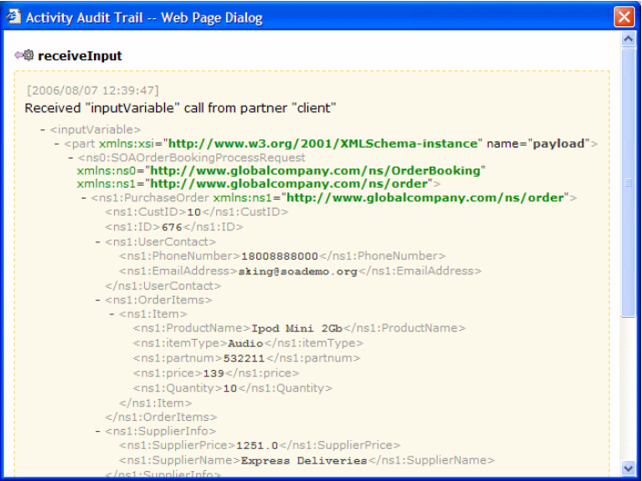
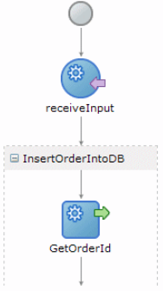
Open the Process Code in BPEL
You still need to edit the BPEL code here:
open

Slide 9
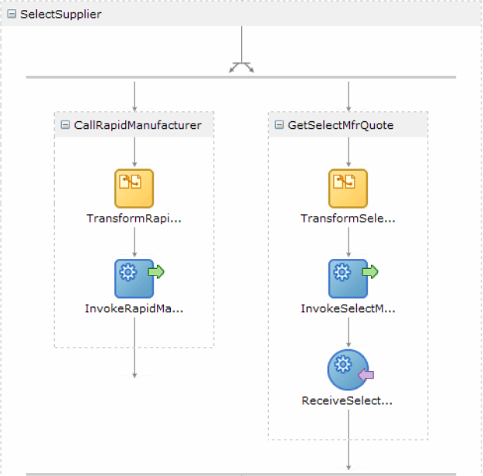
Design parallel activities

Slide 10
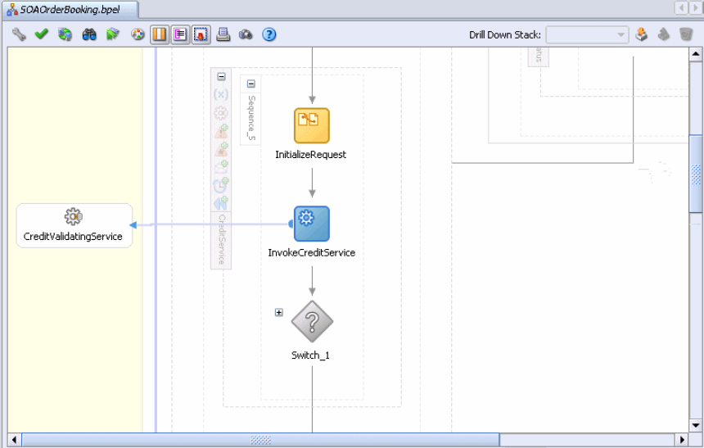
Insert an External Service into the Process
External service added

Slide 11
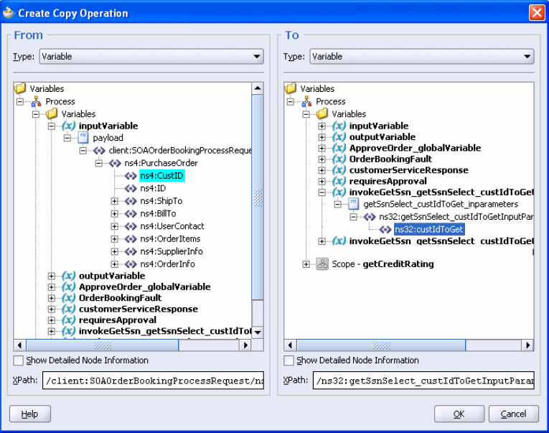
Copy Operation between Variables
Select

Slide 12
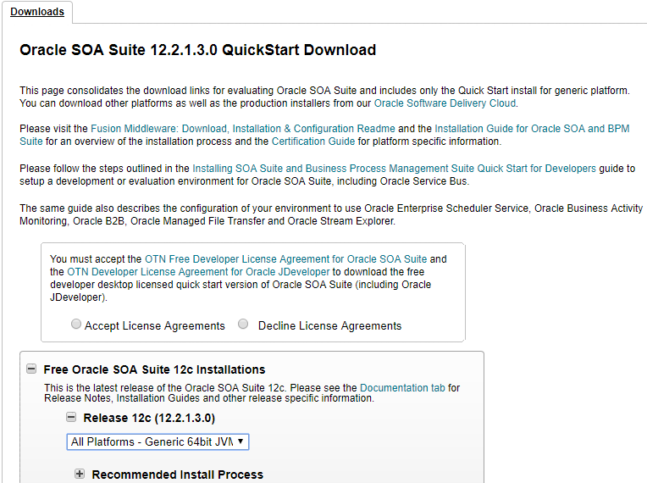
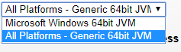
Download and Install Oracle Process Manager
https://www.oracle.com/middleware/technologies/soasuite/downloads.html
Google search

Slide 13
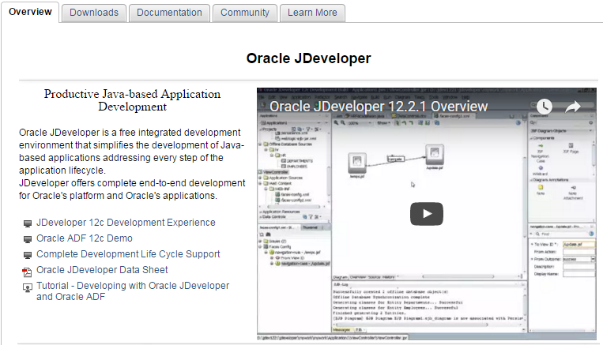
Download and Install Oracle JDeveloper
https://www.oracle.com/technologies/developer-tools/jdeveloper/jdeveloper.html

Slide 14
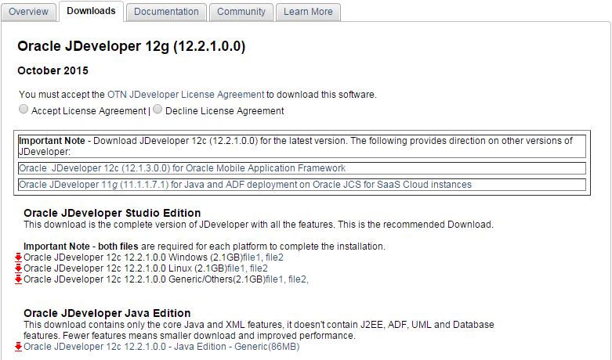
Download and Install Oracle JDeveloper
https://www.oracle.com/technologies/developer-tools/jdeveloper/jdeveloper.html

Slide 15
Steps of Downloading
First, go to this website
http://www.oracle.com/technetwork/middleware/soasuite/downloads/index.html?ssSourceSiteId=ocomen
download :
SOA Suite 12.2.1 - Part 1 of 2
SOA Suite 12.2.1 - Part 2 of 2
Use a folder that's easy to navigate to in Powershell, like Downloads.
2. Important: Extract both .zips into the same folder.
3. Make sure you have JDK 8 installed. If not, download it from here:
http://www.oracle.com/technetwork/java/javase/downloads/jdk8-downloads-2133151.html
4. Now, open Windows Powershell with Administrator privileges. To do this, click the Windows Start button, enter "Powershell" into the search field. Right click on Windows Powershell (x86) and click "Run as Administrator".
5. Navigate to C:/Users/YourName/Downloads or wherever you downloaded the files to.
6. Now in Windows Powershell, enter C:\Java\jdk1.8.0_74\bin\java.exe -jar .\fmw_12.2.1.0.0_soa_quickstart.jar, or whatever is your path to the actual java.exe in your JDK folder.
or, you can use: Powershell with Administrator privileges, navigating to C:/Users/YourName/Downloads, and entering: C:\Program Files\Java\jdk1.8.0_74\bin\java.exe -jar .\fmw_12.2.1.0.0_soa_quickstart.jar
The installer should run with no problem.

Slide 16
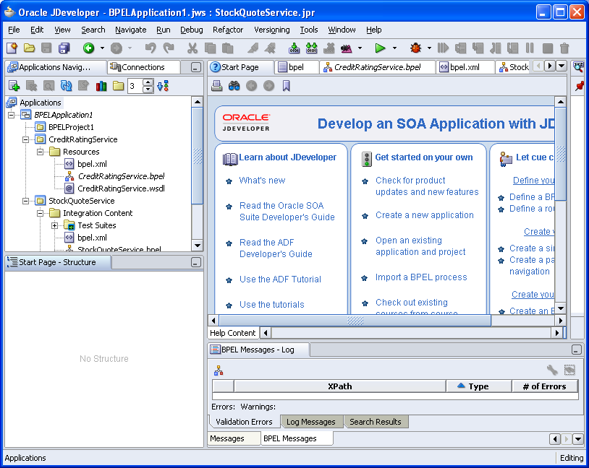
Using JDeveloper

Slide 17
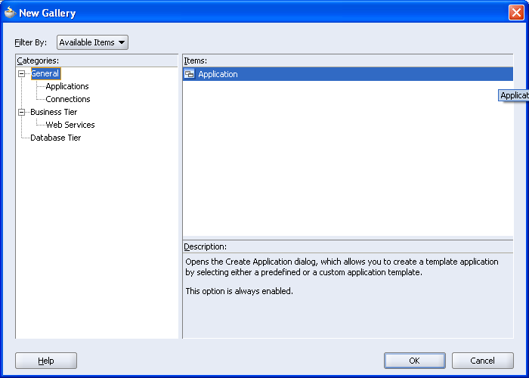
Create a New Application

Slide 18
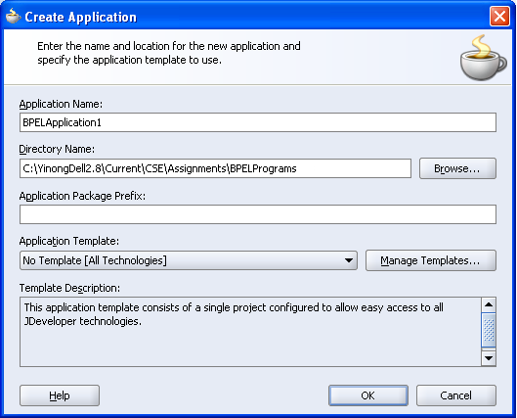
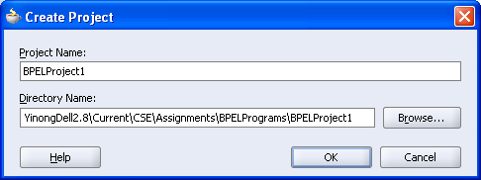
Create an Application and Project

Slide 19
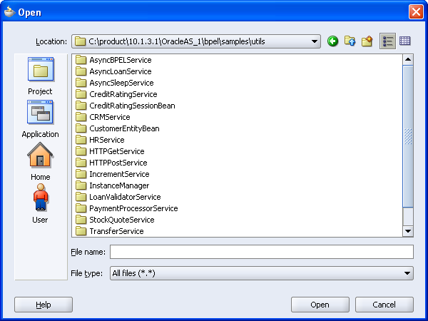
Open an Existing Project in the Folder installed with Oracle Process Manager as Example

Slide 20
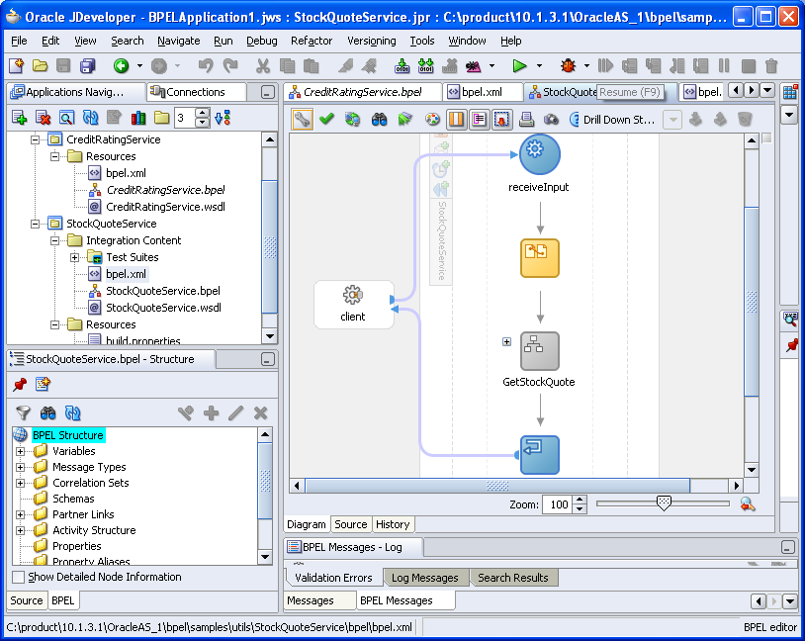
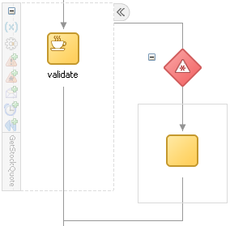
BPEL Process of the StockQuoteService

Slide 21
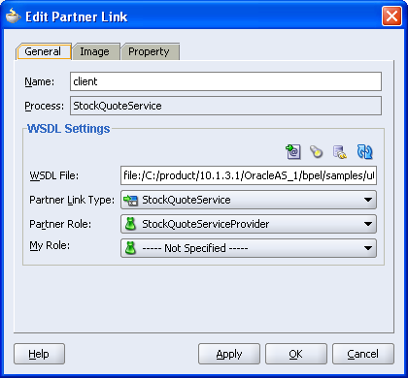
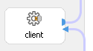
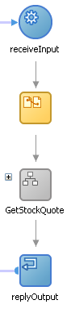
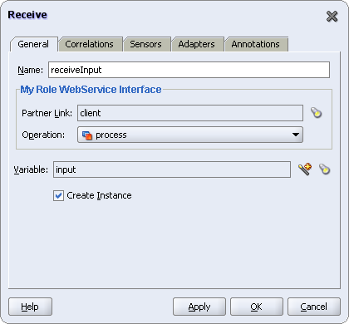

Slide 22
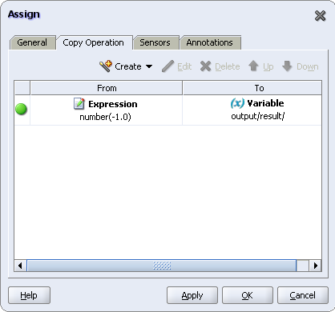
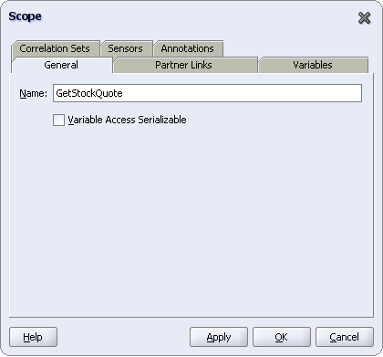
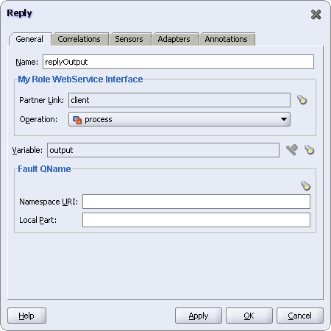

Slide 23
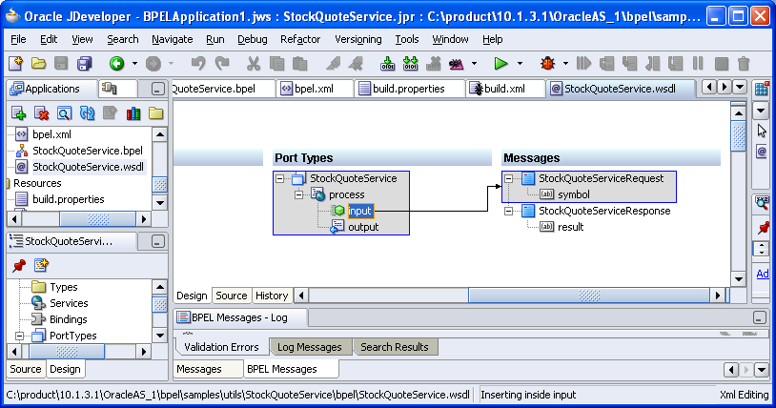
View the WSDL File of the BPEL Process

Slide 24
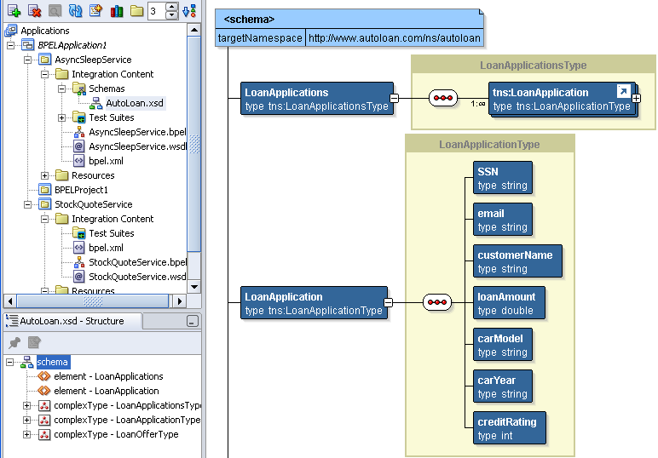
View the XSD Namespace Definition

Slide 25
Oracle SOA Suite and JDeveloper Tutorials
https://docs.oracle.com/cd/E53569_01/tutorials/toc.htm
Google search
BPEL 101 Tutorial
Oracle BPEL Process Manager 10.1.2.0.x Quick Start Tutorial
Tutorial: Using Oracle BPEL to Access Google Services
Accessing nested XML element for variable assignment : https://community.oracle.com/thread/4049486
Download Oracle SOA Suite and JDeveloper: http://www.oracle.com/technology/software/tech/webservices/index.html
http://www.oracle.com/technology/software/products/jdev/index.html
Other tutorials Hello: https://docs.oracle.com/cd/B14099_19/integrate.1012/b14448/hello.htm Using web service: http://docs.oracle.com/cd/E37547_01/tutorials/tut_web_services/tut_web_services.html

Slide 26

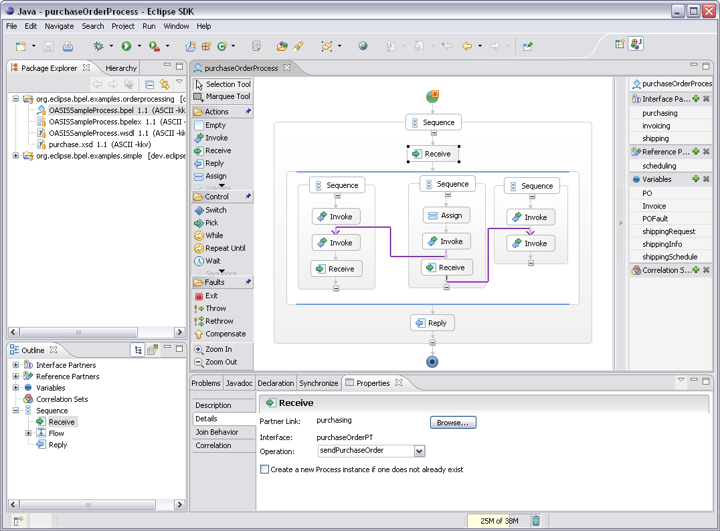
BPEL Designer Project
http://www.eclipse.org/bpel/

Slide 27
Lecture Outline
BPEL Development Frameworks
Oracle SOA Suite: BPEL Process Manager and JDeveloper Designer
http://www.oracle.com/technology/software/tech/webservices/index.html http://www.oracle.com/technology/software/products/jdev/index.html http://www.oracle.com/technetwork/articles/soa/index-095969.html
BPMN and BPMN Development Frameworks
http://www.oracle.com/technetwork/middleware/soasuite/documentation/oracle-bpm-modeling-guide-ps4fp-487996.pdf
Microsoft BizTalk
http://www.microsoft.com/BizTalk

Slide 28
BPEL vs. BPMN: Business Process Modeling Notation
BPEL was developed based on BPMN, Microsoft Xlang, and IBM WSFL in 2002 and was standardized by OASIS in 2003.
BPEL is a text-based process language, which is executable like a programming language. There are many BPEL execution engines.
For convenience, graphic tools have been developed to visualize BPEL process. BPEL flowchart is translated into BPEL XML.
BPMN was developed by BPMI (Business Process Management Initiative) in 2001, which merged with OMG in 2005. BPMN is an OMG standard.
BPMN is a visual notation itself, which carries full semantics. BPMN flowchart can be translated into executable.
Many BPMN development environments translate BPMN flowchart into BPEL process in XML and then use BPEL engine to execute BPMN flowchart .

Slide 29
Workflow Foundation WF, BPEL and BPMN
Visual translation is very difficult.
Standard: BPMN and Visual Tool
BPEL Flowchart using visual tools
?
WF Flowchart
Standard: BPEL Process in XML
Common
Intermediate Language XAML & MSIL
BPMN Service Engine
BPEL Service Engine
MSIL Common Runtime

Slide 30
Oracle Fusion Middleware Family http://www.oracle.com/technetwork/middleware/fusion-middleware/overview/index.html

Slide 31
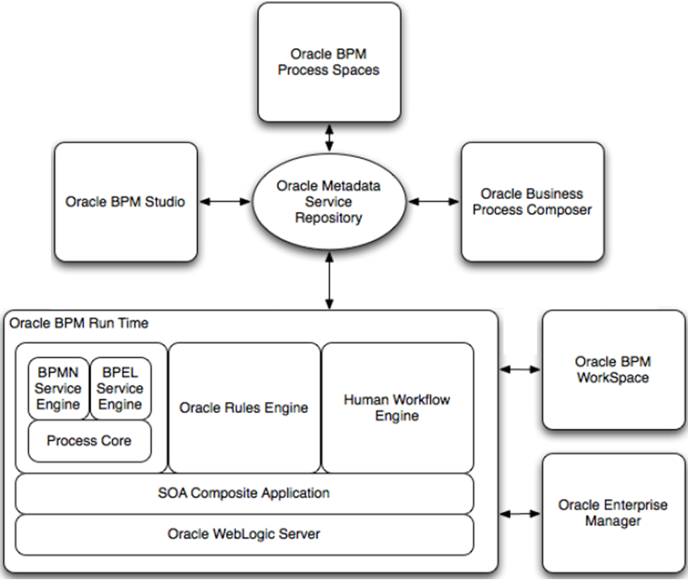
Oracle BPM Suite and Its Components
Oracle BPM Suite
Support the execution of BPMN and BPEL.

Slide 32
Use Oracle BPM Studio to Define Model

Slide 33
The Sales Quote Example Project

Slide 34
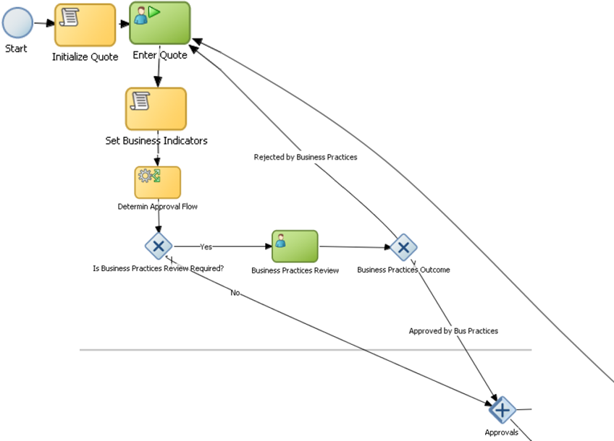
Initiate Quote & Determine Business Practice Review
Task
Flow
BPMN Flow Element:
XOR-Decision
BPMN Flow Element:
XOR-Decision
No
Yes
BPMN Flow Element:
OR-Merge

Slide 35
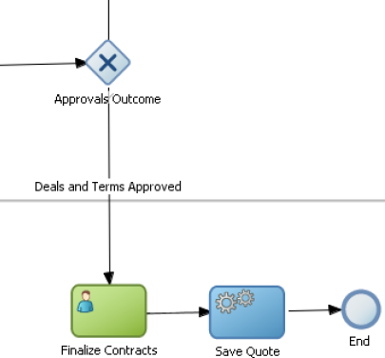
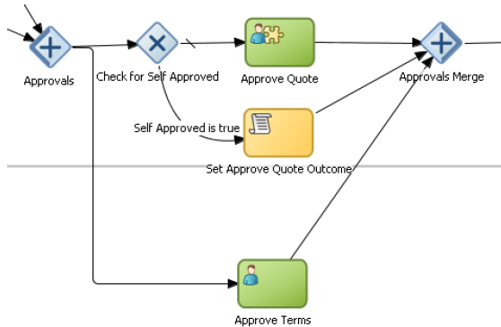
Approve Quote and Outcome
To Enter Quote

Slide 36
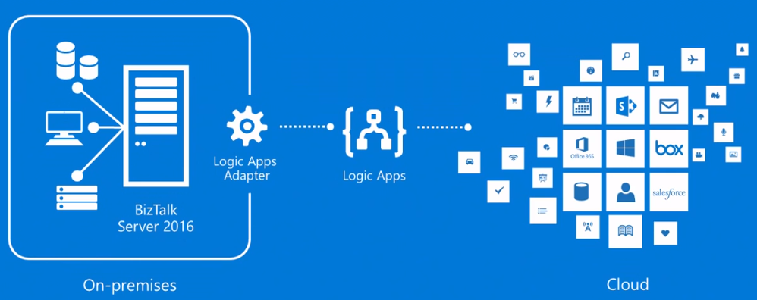
Lecture Outline
BPEL Development Frameworks
Oracle SOA Suite: BPEL Process Manager and JDeveloper Designer
http://www.oracle.com/technology/software/tech/webservices/index.html http://www.oracle.com/technology/software/products/jdev/index.html http://www.oracle.com/technetwork/articles/soa/index-095969.html
BPMN and BPMN Development Frameworks
http://www.oracle.com/technetwork/middleware/soasuite/documentation/oracle-bpm-modeling-guide-ps4fp-487996.pdf
Microsoft BizTalk
https://www.microsoft.com/en-us/cloud-platform/biztalk

Slide 37
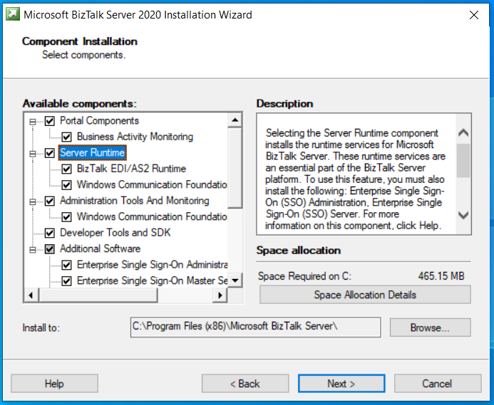
BizTalk 2020 Installation
https://docs.microsoft.com/en-us/biztalk/install-and-config-guides/install-biztalk-server-2020

Slide 38
Microsoft BizTalk Server
BizTalk is business process oriented, while WF is more programming oriented.
It works on .Net Framework and integrated into cloud
It shares most of the interfaces and design tools in .Net Framework
The native language of the process composition is in fact XLang or XLang/s
XLang/s is an improved version of XLang
BPEL can be imported into Xlang/s, and Xlang/s can be exported to BPEL

Slide 39
Integration Server Goals
Integration of heterogeneous systems or Enterprise Application Integration (EAI)
Integration with other Microsoft products such as Windows Server, Visual Studio, SQL Server and Office, InfoPath, SharePoint, Visio, etc.
Integration with partners (B2B)
Management of long-lived (persistent) transactional processes
High performance in demanding conditions

Slide 40
Features of BizTalk Server
Design Goals: Highly available/scalable messaging engine
Support for EAI and B2B integration through BizTalk Process-centric computing (orchestration)
High performance rules/policies engine
Enterprise single sign-on
Service-Oriented Architecture (SOA)
Promotes interoperability and federation
Integrate with cloud computing resources.

Slide 41
Workflow Foundation WF, BPEL and BPMN
BizTalk Orchestration Tool
Standard: BPMN and Tool
BPEL Flowchart using tools
WF Flowchart
XLang Process
Standard: BPEL Process in XML
Intermediate Language MSIL
BPEL Service Engine
BPMN Service Engine
MSIL Common Runtime

Slide 42
Foundation for BizTalk
W3C compliant XML, XSD
Deep native support for creation and consumption of Web Services
WSDL / SOAP Service
HTTP / RESTful Service
UDDI
BPEL
GXA (Global XML Architecture) compliant specification for business process interoperability
Created by MS, IBM, BEA, …
XLang/s
Built on .NET and integrates well with .NET Framework
Notes:
BizTalk® 2004 is a world-class implementation of BPEL4WS.

Slide 43
BizTalk Server Architecture
Administration
Deployment
Process
Management
Trading Partner
Management
Orchestration (Business Process)
Other
Applications
Business
Intelligence
Reporting
Monitoring
Activation & Instance Management
Correlation & Content-based Routing
Message Box (Store)
Message Pipelines (Interrogate/Translate)
Decode
Encode
Decrypt
Encrypt
Authenticate
Sign
Parse
Serialize
Extract
Properties
Custom Components
Send/Receive Adapters
HTTP
SOAP/Web Services
File
SQL
SAP
MQSeries
SharePoint
WSE
3rd Party
Adapters
Custom Adapters
BizTalk
MSMQ/T
FTP
SMTP
EDI

Slide 44
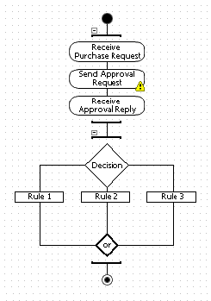
BizTalk Solution: Message Flow
https://docs.microsoft.com/en-us/biztalk/core/lifecycle-of-a-message
Orchestration
XML, Flat File, Binary
XML, Flat File, Binary
Receive Port
Send Port Group (optional)
Receive Location
Send Port
Receive
Adapter
Send Adapter
Decrypt
Parse
Resolve
Party
Serialize
Sign
Encrypt
Receive Pipeline
XML
Send Pipeline
Message Box Database
Tracking Database
Message Box Database
Tracking Database
Management Database
Notes:
Documents/Messages received and send using ports:
Receive Port
Authentication
Tracking
Inbound Maps
Contains 1 to Many Receive Locations
Transport Type
Address (URI)
Receive Handler (BizTalk Host)
Receive Pipeline
Service Window (Start/Stop Date, Enabled, Start/Stop Time)
Send Port Group (optional)
Filters
Contains 1 to Many Send Ports
Supports Primary & Secondary Transports
Transport Type
Address (URI)
Retry Count and Interval
Ordered Delivery
Service Window (Enabled, Start/Stop Time)
Tracking
Priority
Outbound Encryption
Send Pipeline
Filters
Outbound Maps
SQL Server Databases Involved:
BizTalkDTADb
BizTalkMsgBoxDb
BizTalkMgmtDb

Slide 45
Consuming and Exposing XML Web Services
Similar to BPEL, BizTalk orchestration process also exposes as a Web service
BizTalk Web Services Publishing Wizard
VS.NET
Add Web Reference
Service Interface
Service Interface
Call other services
Notes:
Use “BizTalk Web Services Publishing Wizard” to:
Publish BizTalk orchestrations as web services
Publish schemas as web services
Can also consume or expose web services without orchestration if necessary using just content-based routing (CBR) and send/receive ports

Slide 46
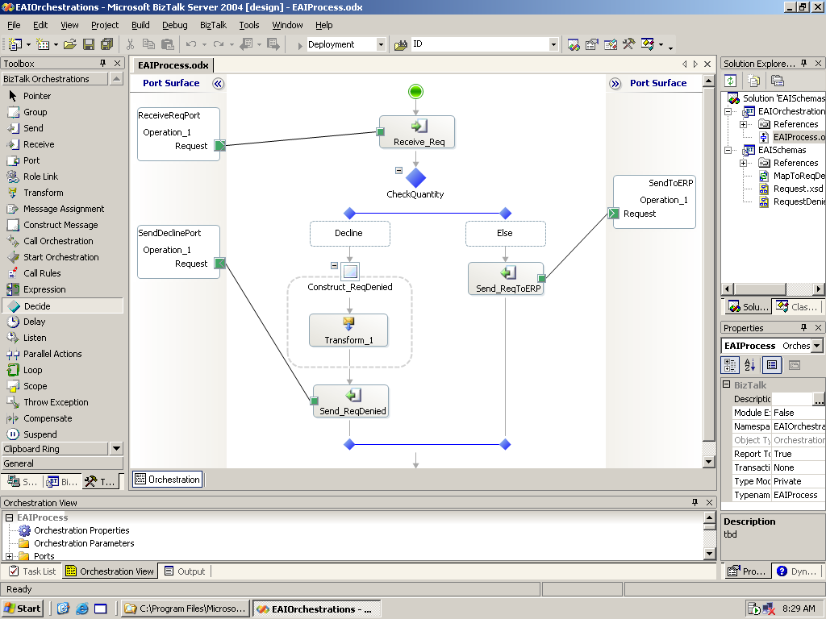
Business Process Design Using Orchestration Designer
Graphically build business processes
Multiple functional shapes- drag and drop
Nested processes
Long running transactions
Simplified correlation
Flexible mapping between messages
Native web service support
BPEL4WS capabilities
Leverage .NET components
Notes:
Orchestration Designer
Common feedback we received from BizTalk 2000/2002 customers was that the tool doesn’t scale well for design of complex business processes. In BizTalk 2004 we enable the tool to scale up for design of larger processes by allowing users to abstract parts of the business process with drill-down capabilities. Another way we allow scaling is through composition – the user can break the process into smaller processes and reuse them.
The other customer feedback we received was that certain common tasks were cumbersome to do such as: i) being able to inline scripts to implement an action in a business process ii) concept of variables iii) simple way to define how incoming messages need to be correlated to schedule instances.
The tool also includes native support for web services – a business process can be the client of a web service or can be used to implement a web service in which case the web service will exposed to clients via WSDL file that can be consumed by VS.NET tools.
Business Process Execution Language for Web Services Version 1.1
http://msdn.microsoft.com/library/default.asp?url=/library/en-us/dnbiz2k2/html/bpel1-1.asp
5 May 2003
Authors (alphabetically): Tony Andrews, Microsoft; Francisco Curbera, IBM; Hitesh Dholakia, Siebel Systems; Yaron Goland, BEA; Johannes Klein, Microsoft; Frank Leymann, IBM; Kevin Liu, SAP; Dieter Roller, IBM; Doug Smith, Siebel Systems; Satish Thatte, (Editor) Microsoft; Ivana Trickovic, SAP; Sanjiva Weerawarana, IBM
Web Services Flow Language (WSFL 1.0)
http://www-3.ibm.com/software/solutions/webservices/pdf/WSFL.pdf
May 2001
By Prof. Dr. Frank Leymann, Distinguished Engineer
Member IBM Academy of Technology
IBM Software Group
The Web Services Flow Language is the result of a team effort:
Francisco Curbera, Frank Leymann, Dieter Roller and Marc-Thomas Schmidt created the language and its underlying concepts.
Matthias Kloppmann and Frank Skrzypczak focused on its lifecycle aspects. Francis Parr worked on details of the example in the appendix.
Many others helped by reviewing and discussing earlier versions of the document, most notably Sanjiva Weerawarana and Claudia Zentner.

Slide 47
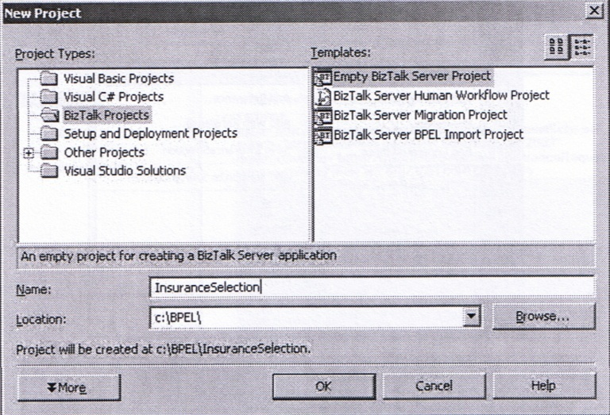
Creating a New BizTalk Project

Slide 48
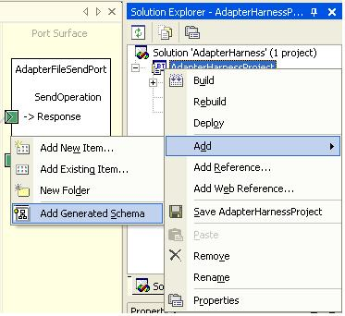
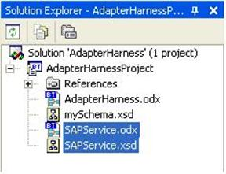
BizTalk Solution Explorer
Allows you to add references and Biztalk items/schema, compile and deploy your solution

Slide 49
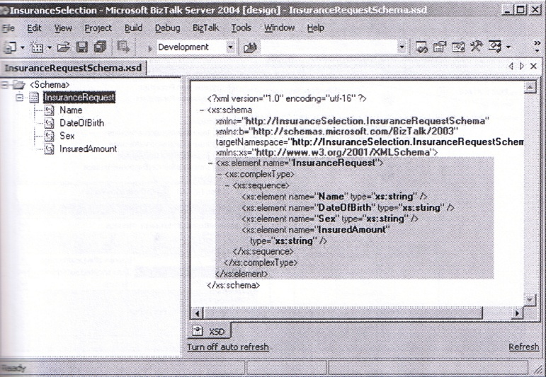
Define the Types to be Used in XML Schema

Slide 50
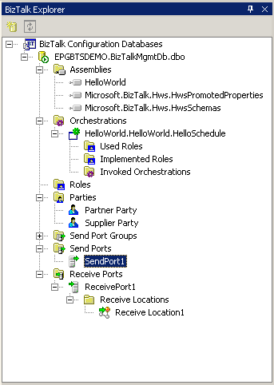
Configuration Management Using BizTalk Explorer in VS.NET
Connects to SQL BizTalkMgmtDb
View deployed BizTalk assemblies and undeploy
Bind to send/receive ports and hosts
Enlist/Unenlist and Start/Stop orchestrations
Configure Send and Receive Ports/Groups
Configure Roles and Parties

Slide 51
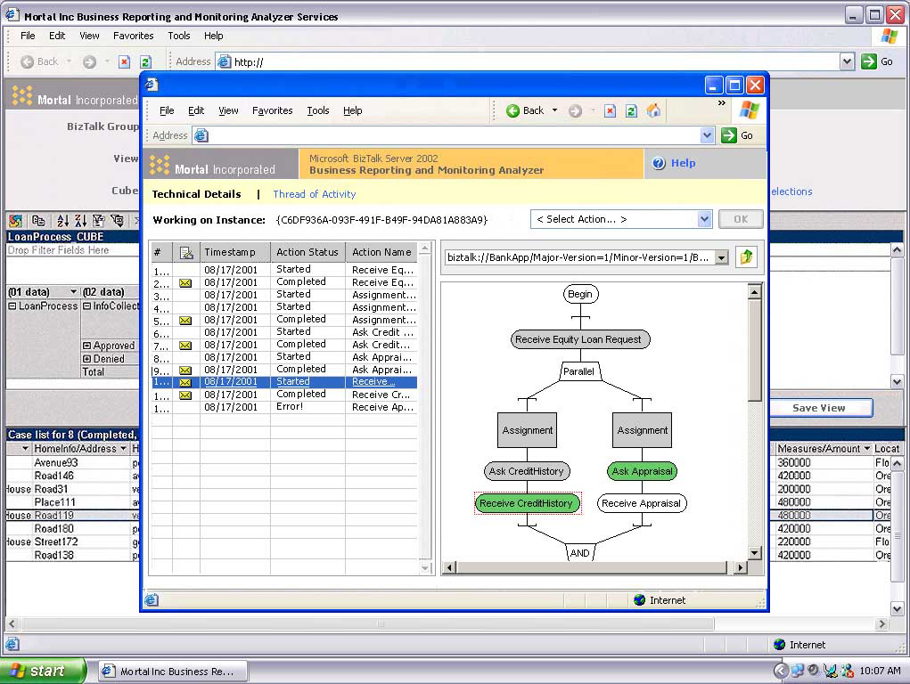
Activity Tracking: Single Step Execution
View a real time process End-to-End
Track
Messages
Processes
Debug
Suspend
Resume
Manage
Suspended
Messages

Slide 52
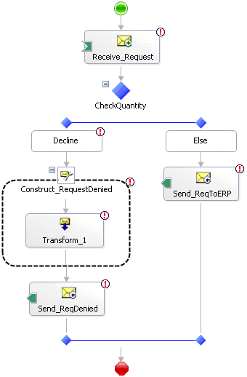
BizTalk Business Process Example
https://msdn.microsoft.com/en-us/library/aa561630.aspx

Slide 53
Business Rules/Policies Engine
Business Rules: describe, constrain, and control the structures, operations, policies, and strategies of a business
Decision making within a business process
Graphical tool to create rule sets or policies
Rules allow the user to:
Capture and represent business policies separate from application data and code
Make policy changes frequently and quickly
Eliminate the need to recompile, redeploy orchestrations to pick up changes
Rule engine built to efficiently process a large number of rules, in parallel with the process execution engine!
Notes:
Simple example:

Slide 54
Connect the Pieces and Rules
Validation Rule:
A valid credit card number must be provided
Human
based
workflow
Customization Rule:
If the purchase amount is over 500
Then obtain Manager’s approval
Business process
Discount Rule:
If Customer is a Gold Customer
Then Apply 10% discount
Workflow customization
Dynamic Business Policy management
Cross-Field/Constraint Validation
Decision support
Business Process Automation Engine
Orchestration
Rulebase
Key Performance Indicators (KPI) Reasoning
Tracking
Service
Service
Service
Routing Rule:
If the customer wants to buy cars
Then route to Ford dealer
If the customer wants to buy books
Then route to Barnes and Nobles
Business Activity
OLAP
Messaging Bus
Intelligent Routing
Intelligent Notification
Purchase Volume Rule:
If the purchase volume is over 100
Then launch the premier procurement process
Notification
If purchase order amount is more than $1000
Then notify sales manager

Slide 55
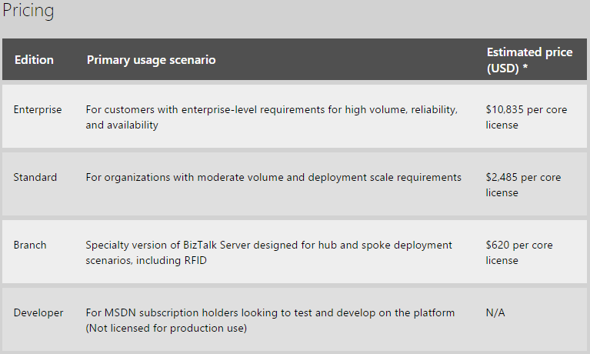
BizTalk Pricing
https://www.microsoft.com/en-us/cloud-platform/biztalk-pricing
in 2016
Checked in 2010:
Enterprise Edition: $29,999
Standard Edition: $8,499
Developer Edition: $499 per user
Complete EAI, B2B, and Business Process Management functionality
Includes all current and new application and technology adapters
Limited solely to designing, developing, and testing solutions

Slide 56
Lecture Summary
Oracle BPEL Process Manager and Designer
Overview
Download and Install
Oracle BPEL Process Manager
Oracle JDeveloper
Eclipse BPEL Designer
BPMN and BPM Framework
BPMN Example
Compared BPEL, BPMN, WF, and BizTalk
Microsoft BizTalk
Overview
Message Flow
BPEL Conversion
Rules/Policy Engine
Tracking and Debugging

